Slide 1
Canvas Download
Team member:
Shengjie Hu
Mingju He
Jingyi Hu

Slide 2
Tasks:
1.Download files from course Dov_Dev.
2.Extract information from file and store data.

Slide 3
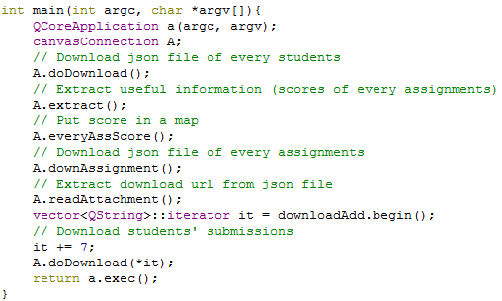
5 steps:
1. Connect to Canvas
2. Download Files
3. Analysis and Extraction
4. Download Submission
5. Storing Data

Slide 4
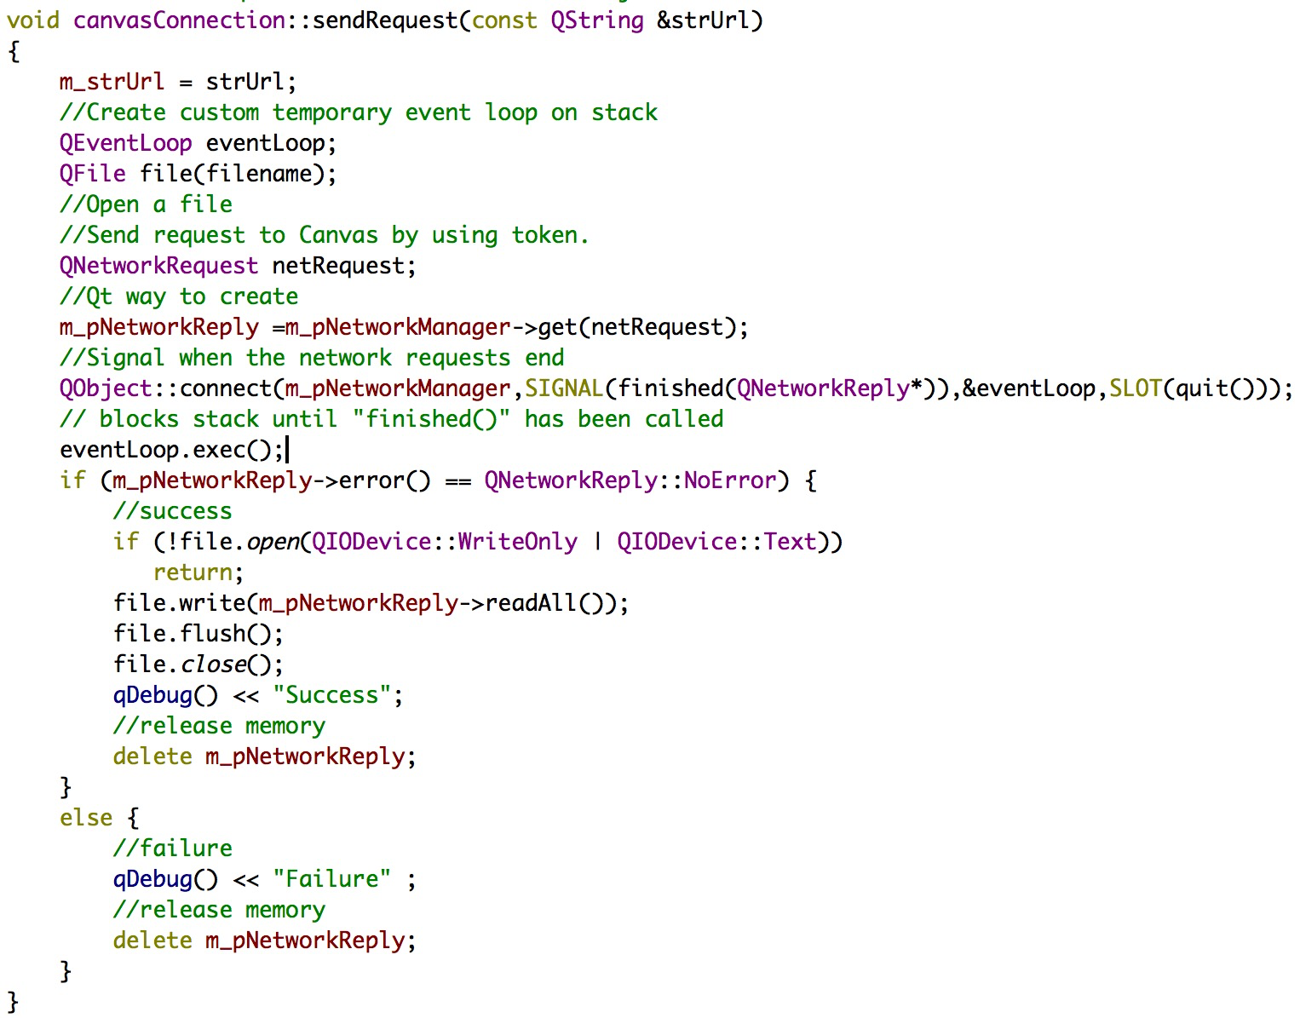
1.Connect to Canvas
Our team write this function to connect to a website by input the URL
Ex: CanvasConnection A;
A.sendRequest(“https://www.google.com”);
Output: Qt will create a file that includes the content of https://www.google.com.

Slide 5


Connect to Canvas
HTTP & HTTPS
Mac:
Win:

Slide 6
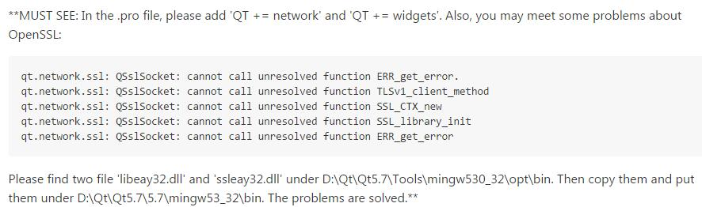
Solve problems about OpenSSL:
We have posted this solution on Github.

Slide 7
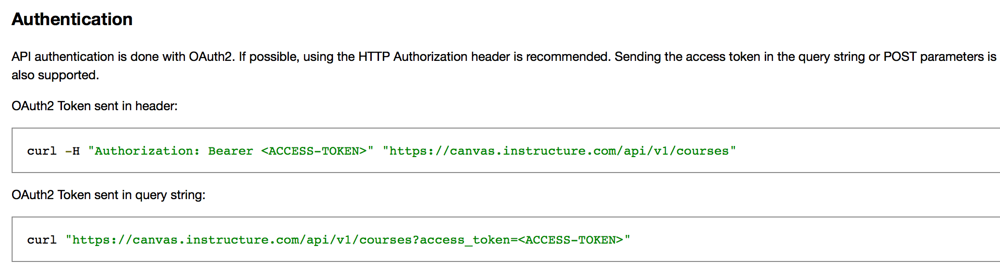
When we login in Canvas
We need password.
When we use this function to connect to Canvas.
We need a token.

Slide 8
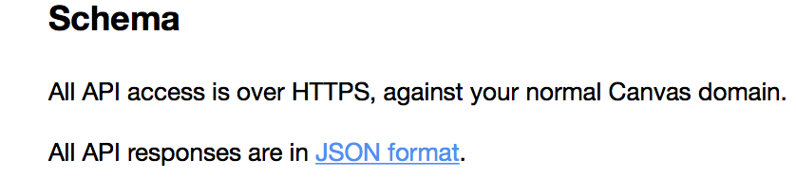
2.Download file
What will we get?
Since all API responses in canvas are in JSON format.
Our team has to download them and analyze.

Slide 9
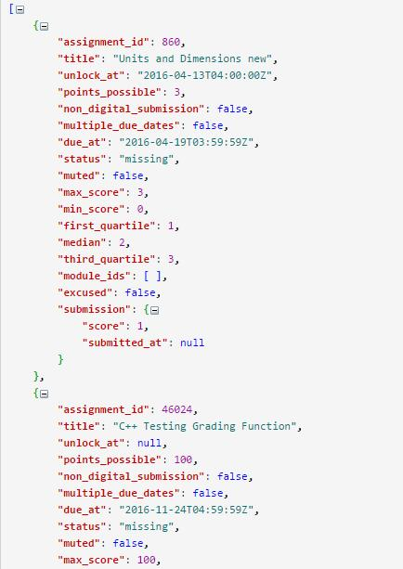
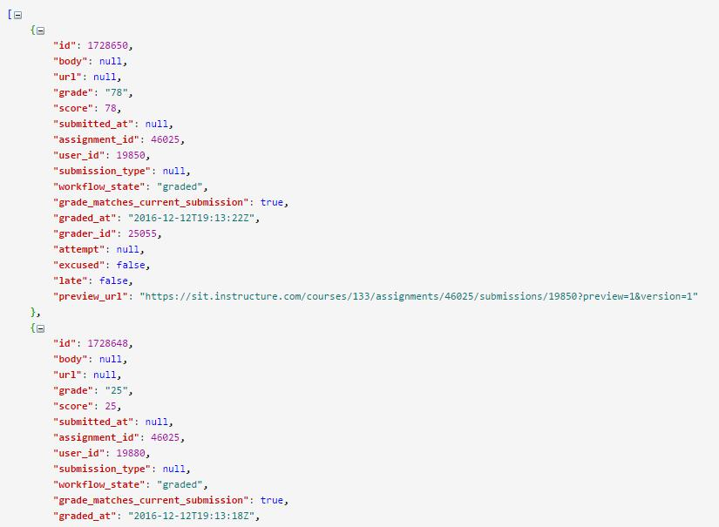
File A:
File B:
A:
https://sit.instructure.com/api/v1/courses/10300000000000133/analytics/users/10300000000020089/assignments?access_token=<ACCESS-TOKEN>
B:
https://sit.instructure.com/api/v1/courses/10300000000000133/assignments/10300000000000860/submissions?access_token=<ACCESS-TOKEN>
Notes:
distinguished

Slide 10


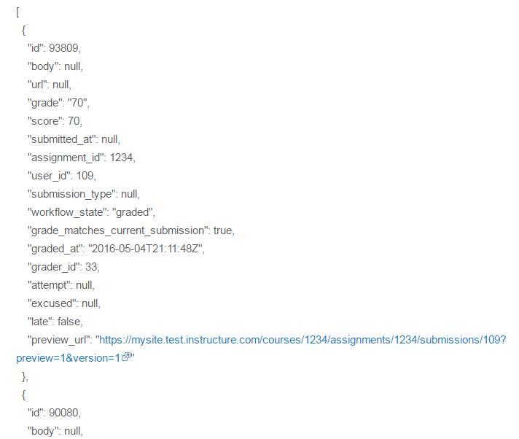

3.Analysis and Extraction
Array
Square brackets around it
Object

Slide 11
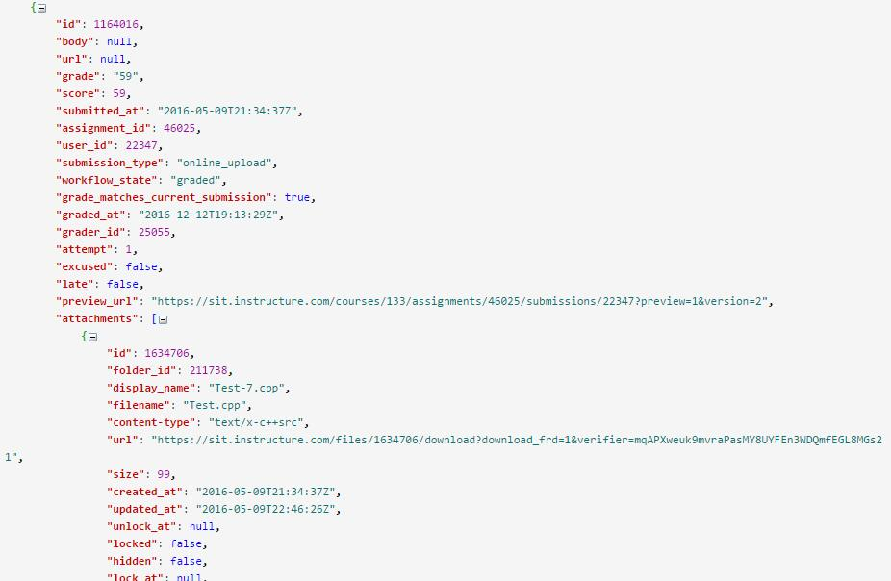
How To Extract?
Array
Object
Array
Object

Slide 12
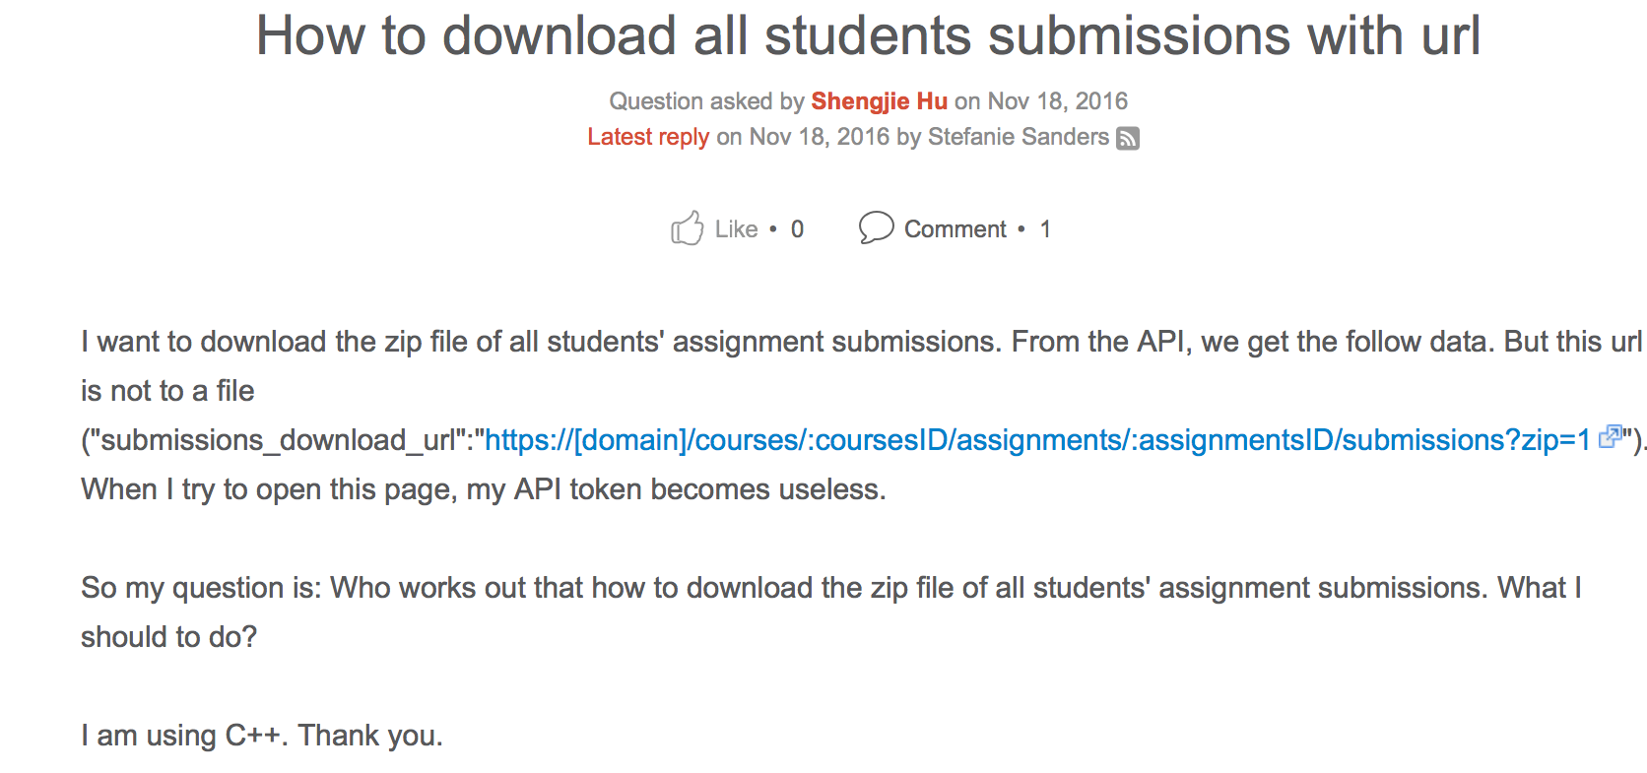
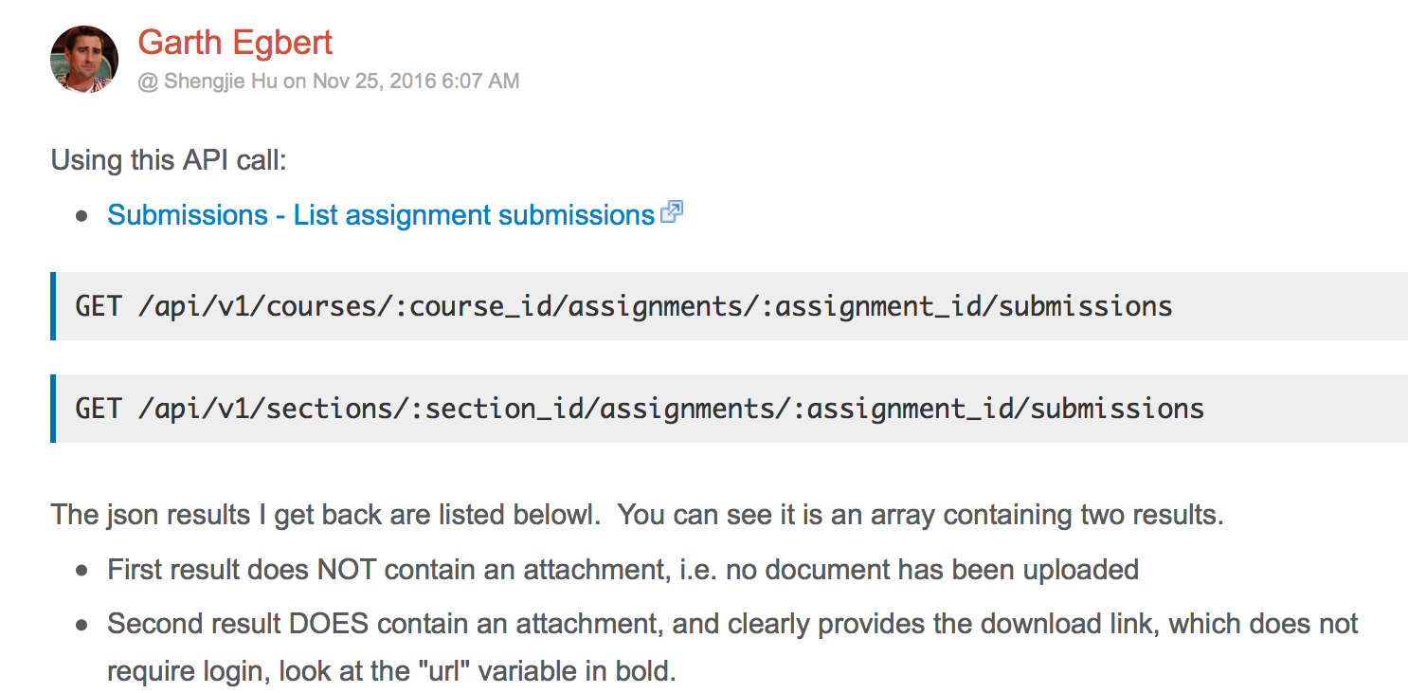
4. Download Submission
Q:
Our team meets a problem that we cannot download files from Canvas because the URL for download needs user to login in.
A:
This guy helps us out. The “attachment” gives us the download link which does not need user to login in.

Slide 13
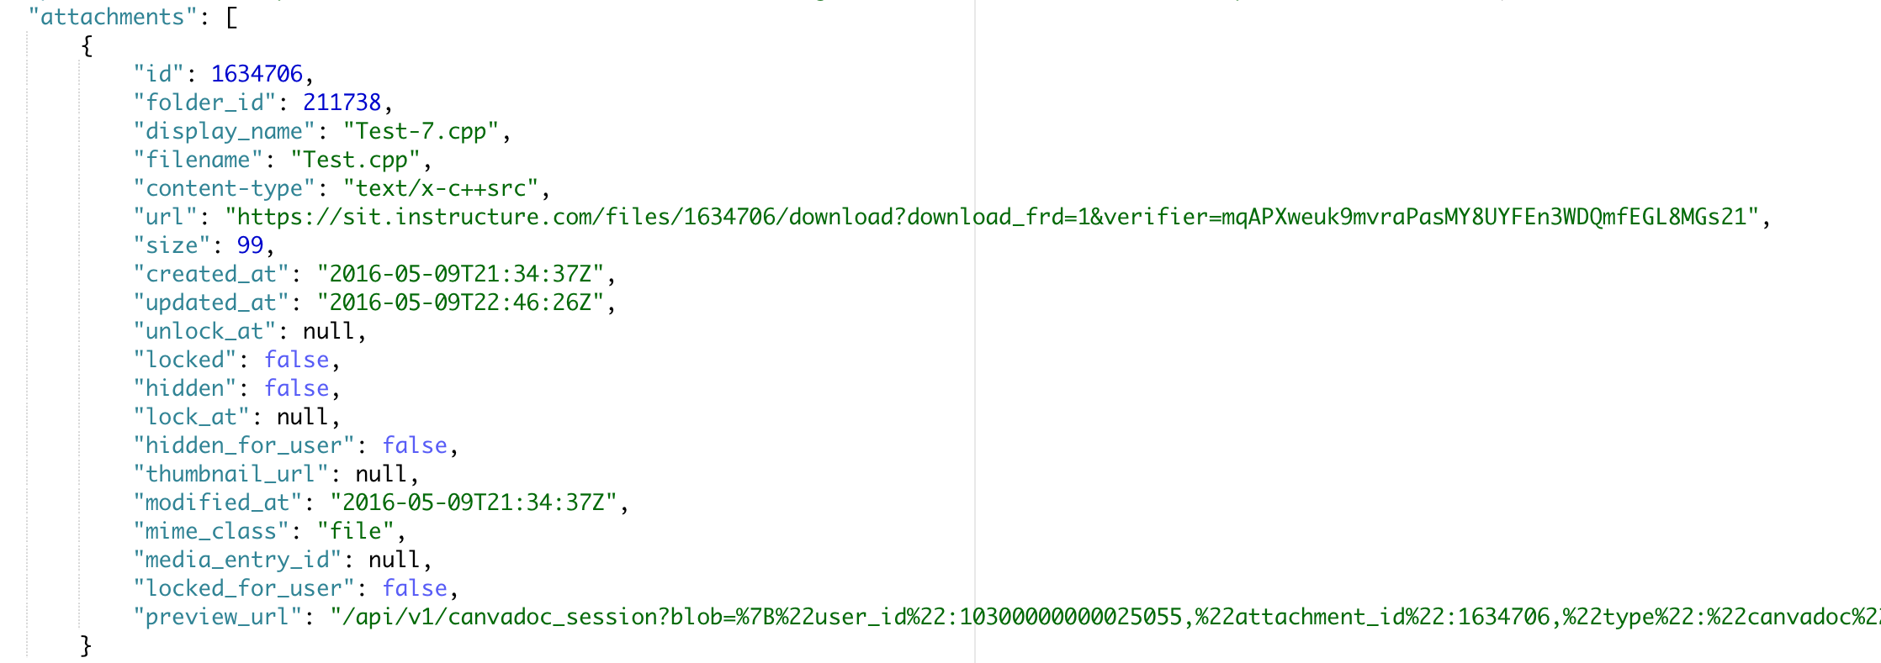
Here is an attachment:
Although we could download Test-7.cpp from canvas directly without logging in by the URL given by attachments, we still have one problem.

Slide 14
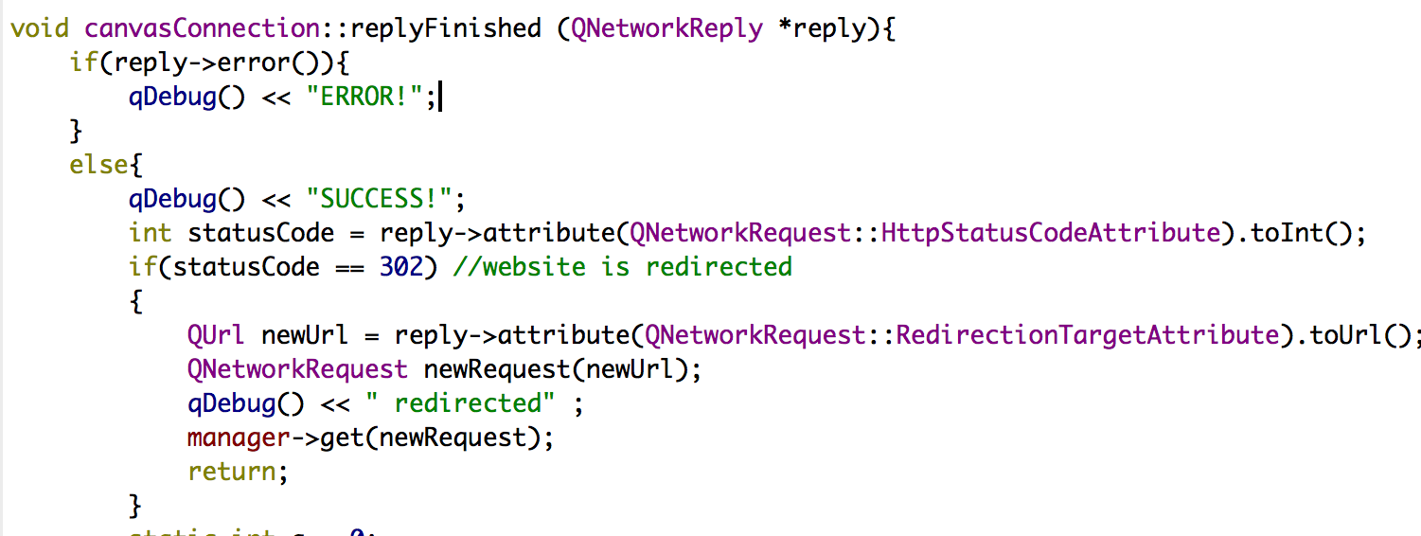
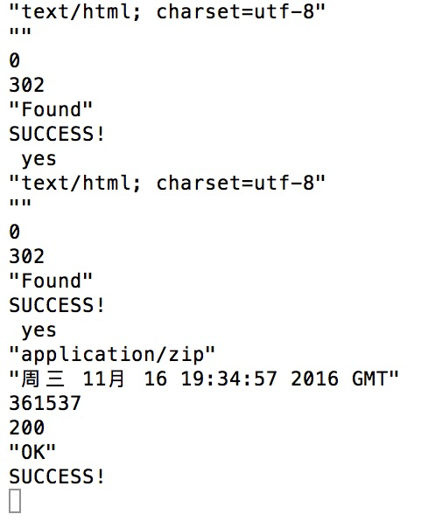
Solution:
We write some codes to ensure the program could reach the final web.
This is the output to send request to that URL. We received error 302 two times ,which meant we were directed to another web two times and then reached the final web.

Slide 15
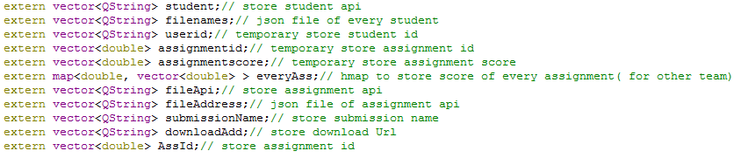
Vector and Map
5. Storing Data

Slide 16
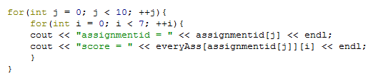
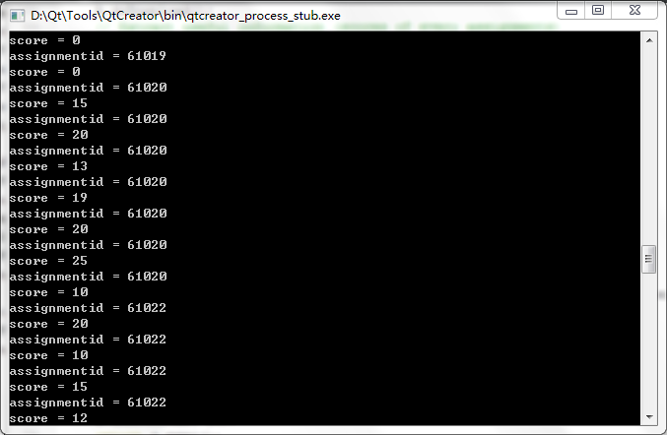
Scores of every assignment:
map<double, vector<double> >

Slide 17

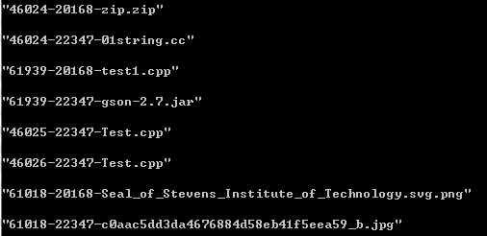
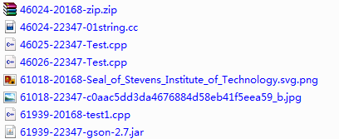
Submission:
assignment_id + "-"+user_id + "-" + fileName
vector<QString> submissionName

Slide 18
Thanks

